Slide 1
CookItUp
An easy-to-use mobile app that suggests recipes with your available ingredients
Avantika Mishra – 2022SP93049
Hritika Dhasal – 2022SP93058
Amit Raj – 2022SP93059

Slide 2
Table of Contents
01
02
03
04
About Project
Architecture/Design
Overview and objectives of our project
Choices to achieve the best performance and user experience
Preview of App
Highlighting Features
A brief preview of how our app looks
Challenges and interesting aspects of our project

Slide 3
About Project

Slide 4
A cross-platform application designed for users who want to create delicious meals using the ingredients they have on hand. The app leverages the power of Large Language Models (LLMs) and image recognition technology to identify edible ingredients from images provided by the user and then recommends detailed recipes based on these ingredients.
After carefully evaluating numerous available APIs and techniques, we opted for the Google Vision API to identify edible ingredients within images. And for generating valid recipes, we are leveraging the cutting-edge technology of Generative AI.

Slide 5

Architecture
The basic design and architecture, that we used to ensure robust performance and seamless user experiences across diverse devices and platforms.

Slide 6






Response status sent
If(image) searchQuery = imageURL
If image, imageUrl sent
If(!image)
searchQuery = formData
Labels Returned
Server
Image Upload
Google Cloud Vision API
Image URL
Prompt + Labels
Recipe as Response
Stores state of the request
MongoDB to store state of the Process
Cloudinary
GPT 3.5 Turbo API

Slide 7

Preview

Slide 8
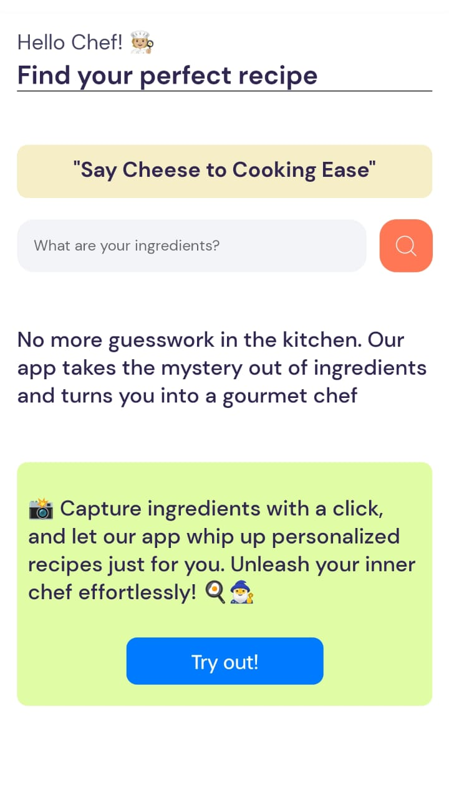
Home Page
Text input box where user can enter ingredients directly as text
Redirect to camera where users can click the image of the ingredients

Slide 9
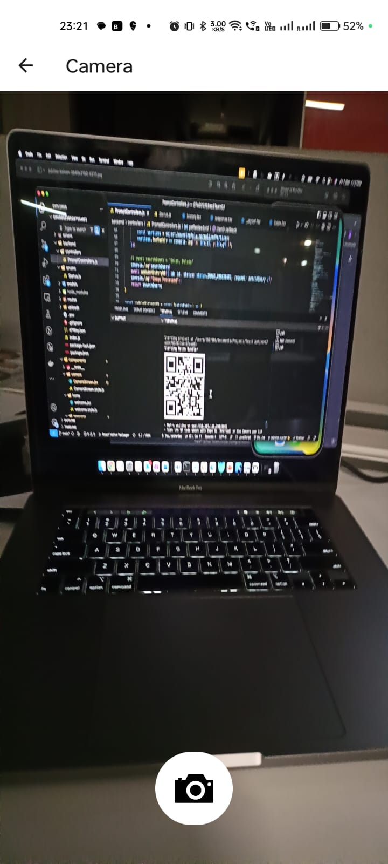
Camera Screen
This is how our camera screen looks, while the user tries to click a picture to send to the backend

Slide 10
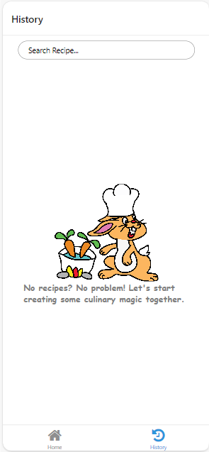
Fresh History Page
History Page appears blank like this when there us no data in the db.

Slide 11
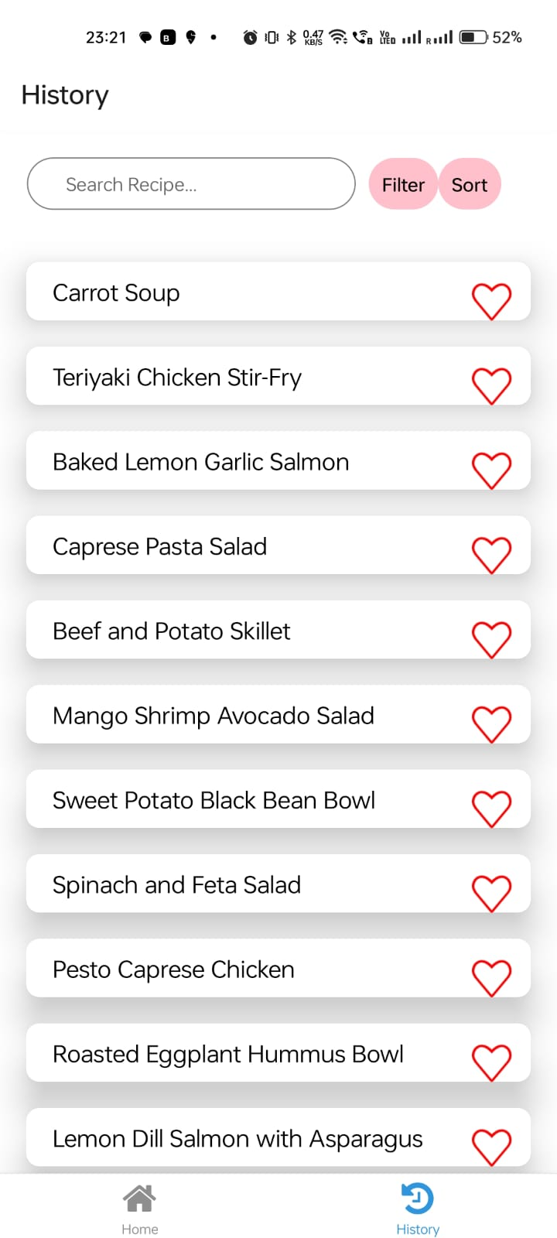
History
History Page that displays top 10 Search Results and lets users search within that.

Slide 12
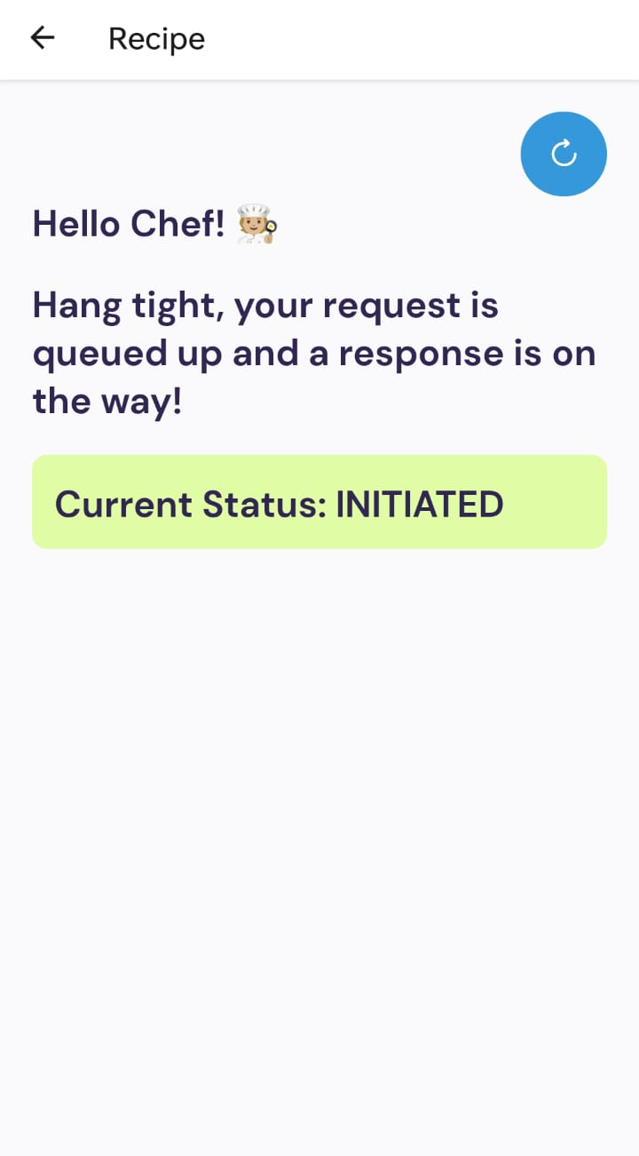
Response Screen
Users see this screen after submitting their picture or text query. This tells them the status of their query, and finally returns the recipe.

Slide 13

Highlighting Features
Some challenging yet interesting aspects of our project.

Slide 14
Workflow for input-type == Image
Cloudinary
LLM
Object Recognition
Media Management Solution
Prompt Engineering
We pass the imageUrl obtained from Cloudinary to the vision API to identify the items in the given image
It helps in efficient cloud-based media management and optimization. Opting for Cloudinary, our solution streamlines image management by uploading images to the platform, securing optimized URLs for seamless integration across APIs. Additionally, Cloudinary's resizing capabilities ensure quality preservation, mitigating potential issues stemming from large image sizes.
Finally, we perform prompt engineering to identify edible items from the identified labels, and suggest recipes using them.
Google Vision API

Slide 15

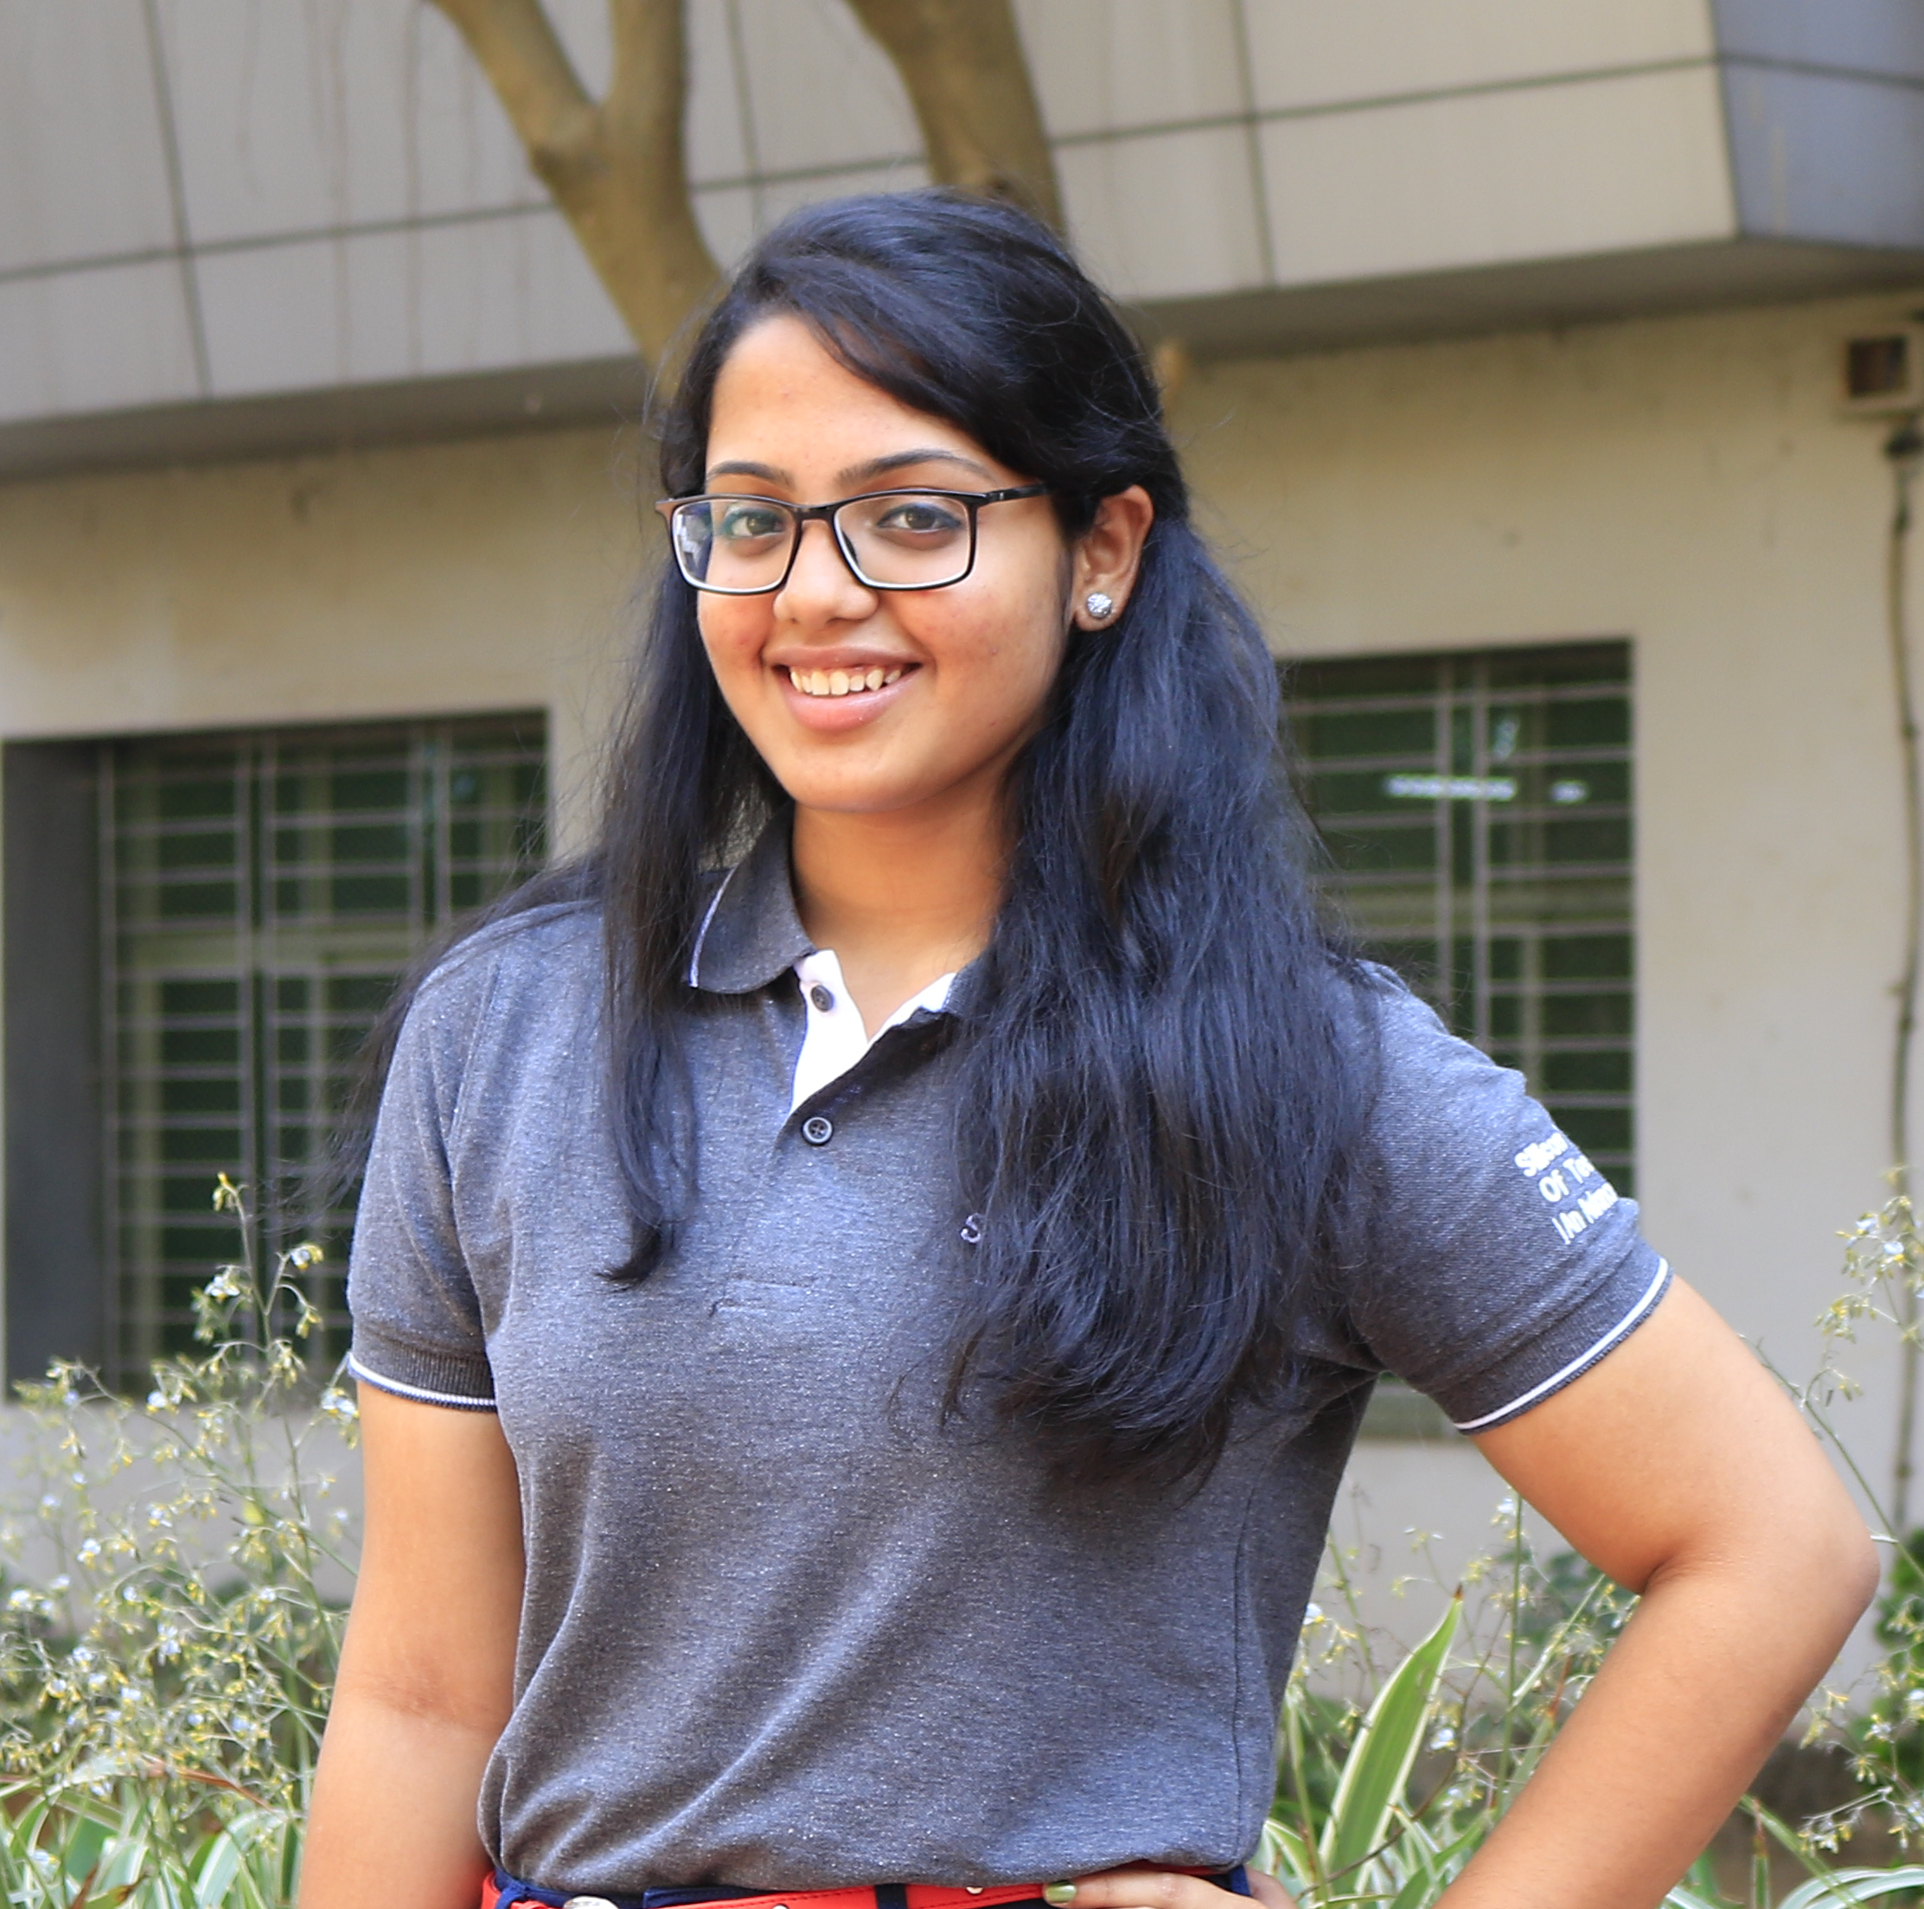

Our Team
Amit Raj
Avantika Mishra
Hritika Dhasal
Full-stack developer
2022SP93059
2YB 2022
Back-end developer
2022SP93049
2YB 2022
Front-end developer
2022SP93058
2YB 2022

Slide 16
Thanks!
Please keep this slide for attribution

